Slide 1
Introduction to Big Data
Week 1
Nasheb Ismaily
nismaily@bellevue.edu

Slide 2
Course Objectives
Understand
Understand the concept, importance, and challenges of Big Data
Introduce
Introduce the Hadoop ecosystem and its components
Explain
Explain distributed storage and processing
Explore
Explore use cases of Big Data in various industries

Slide 3
What is Big Data?
Definition: Big data is a field that treats ways to analyze, systematically extract information from, or otherwise deal with data sets that are too large or complex to be dealt with by traditional data-processing application software.
The 3 Vs of Big Data:
Volume: Amount of data generated through various sources
Velocity: Speed at which new data is generated and moved
Variety: Different types of data (structured, unstructured, semi-structured)

Slide 4
Challenges of Big Data
Capturing Data: High velocity and volume data can be difficult to capture and record.
Storing Data: Large data sets require significant storage capacity.
Analyzing Data: Extracting meaningful insights from large, complex datasets can be challenging.
Searching Data: With large datasets, it can be difficult to find specific information.
Sharing Data: Transferring large amounts of data can be time-consuming and resource-intensive.
Visualizing Data: Presenting data in a comprehensible manner can be challenging with big data.
Privacy Concerns: The more data collected, the bigger the concern for data privacy.

Slide 5
Introduction to Hadoop
Hadoop is an open-source software framework that allows for distributed processing of large datasets across clusters of computers using simple programming models.
It's designed to scale up from single servers to thousands of machines, each providing local computation and storage.

Slide 6
Hadoop Ecosystem Components
HDFS: A distributed file-system that stores data on commodity machines, providing high aggregate bandwidth.
YARN (Yet Another Resource Negotiator): A resource-management platform responsible for managing compute resources in clusters and using them for scheduling applications.
MapReduce: A programming model for large scale data processing.
Spark: An open-source distributed computing system that can process data in parallel.
Hive: A data warehousing infrastructure built on top of Hadoop that provides data summarization, query, and analysis.
HBase: A distributed, scalable, big data store, modelled after Google's Bigtable.
NiFi: An open-source software project designed to automate the flow of data between software systems.
Kafka: A distributed streaming platform that uses publish-subscribe model.
Solr: An open-source search platform built on Apache Lucene.

Slide 7

Understanding Distributed Storage
Distributed Storage spreads data across a network of connected machines.
HDFS operates on the principle of distributed storage. It splits large data files into smaller blocks (default 128MB), then these blocks are distributed across the cluster of machines.
HDFS follows a master/slave architecture with NameNode as master (maintaining metadata) and DataNode as slave (stores actual data).

Slide 8
Deep Dive into Distributed Storage
How HDFS works: When data is stored, it is broken into "blocks" and distributed across different nodes in the cluster, ensuring fault tolerance and high availability. Blocks are replicated across nodes to ensure data is never lost, even in the case of a node failure.
Block Size in HDFS: The default block size in HDFS is 128MB. The block size can be increased to better handle large files, but very small files can lead to inefficient use of space.
Role of NameNode: The NameNode keeps track of how the data file is broken into blocks, where these blocks are stored in the cluster, and the health of the DataNodes. When a client wishes to read a file, the NameNode provides the addresses of the DataNodes containing the blocks of data.
Role of DataNode: DataNodes are responsible for storing, retrieving, and processing data. They regularly send heartbeats to the NameNode to confirm they are functioning properly.

Slide 9
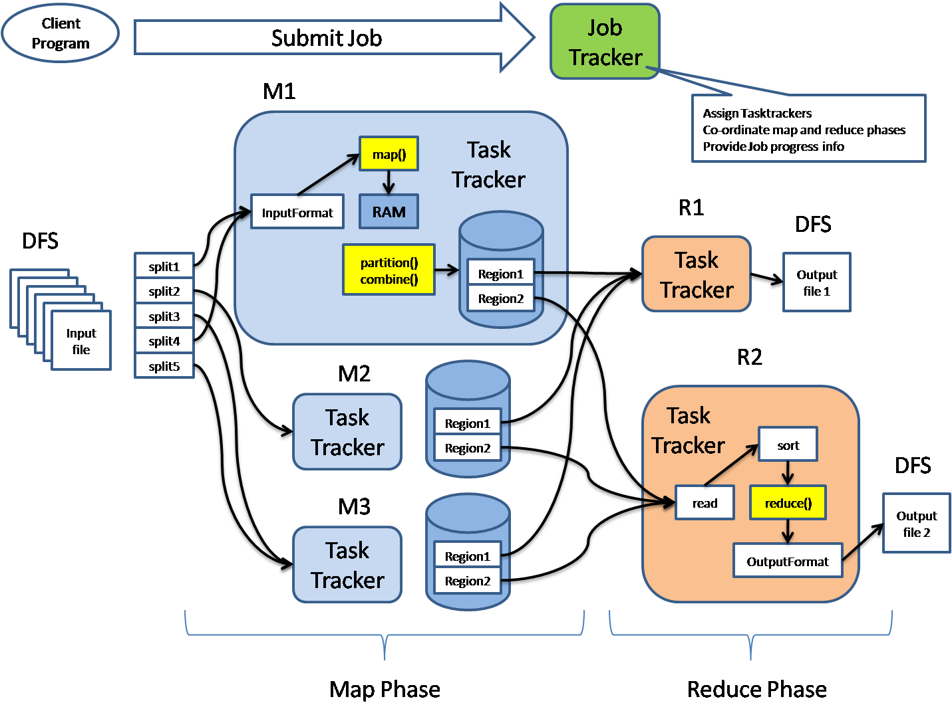
Understanding Distributed Processing
Distributed processing is the method in which a task is divided into multiple tasks that are processed independently on several machines.
MapReduce is the key to distributed processing in Hadoop. It splits the input data-set into independent chunks which are processed by the map tasks in a parallel manner. The framework sorts the outputs of the maps, which are then input to the reduce tasks.

Slide 10
Deep Dive into Distributed Processing
How MapReduce works: The Map function breaks down a task into smaller sub-tasks. It processes input data to produce a set of intermediate key-value pairs. The Reduce function takes these intermediate key-value pairs and combines them to generate the output.
Data Locality in MapReduce: MapReduce takes advantage of "data locality" by moving the computation to where the data resides on the node, thus minimizing network congestion and increasing the speed of the computation.
Fault Tolerance in MapReduce: The framework automatically handles failures. If a machine with a copy of the input data fails during a job, the job is automatically redirected to a copy of the data on another machine.
YARN (Yet Another Resource Negotiator): It's the cluster management component of Hadoop. It oversees resource allocation, job scheduling, and manages the distributed applications running on the cluster.

Slide 11
Big Data Use Cases
Healthcare: Big data is used for predictive analytics, patient monitoring, drug discovery, and telemedicine.
Retail: Used for customer segmentation, personalized marketing, inventory management.
Banking: Fraud detection, risk management, customer analytics are some of the applications.

Slide 12

Big Data Case Study
Netflix uses big data for personalizing content recommendations, optimizing streaming and buffering techniques, and even in the creation of new series and movies.

Slide 13
Assignment: Deploying Big Data Infrastructure
Option 1: Local Deployment using Virtual Machine
Option 2: Cloud Deployment using Google Cloud
Choose one option and stick with it for the entire semester
Detailed instructions can be found in the course material
Submission: Screen Shot of the working User Interfaces in the deployment instructions.

Slide 14
A private, non-profit institution founded in 1966, Bellevue University is accredited by the Higher Learning Commission through the U.S. Department of Education. For general information, please call 800.756.7920. Email: nismaily@bellevue.edu bellevue.edu

